Slide 1
Presentation On AirQo African Air Quality Prediction
By:
Ejifolabi Emmanuel Oludare

Slide 2
Introduction
Objective
About the Dataset
The objective is to estimate PM2.5 levels from satellite observations based on Aerosol Optical Depth (AOD) for eight cities in seven African countries - Lagos, Accra, Nairobi, Yaounde, Bujumbura, Kisumu, Kampala, and Gulu - with varying ground monitoring resolutions, using appropriate machine learning algorithms.
Ground-based observations in the selected cities will be used to validate the satellite estimates.
The dataset is given as a project from UnvelCity and the number of rows are 8071 with 80 columns. There are many factors that may determined the air quality and they are given as the feature on the dataset. The target variable is pm2_5.
Evaluation Metrics
The evaluation metric for this competition is Root Mean Squared Error.

Slide 3
Data Inspection
Overview
Summary Statistics
After Importing all necessary libraries and loading the dataset, it was observed that:
The dataset contain 8071 numbers of rows or entries.
The dataset has 80numbers of Columns.
The features are 79 in numbers e.g. id, site_id, country, city, date, hours e.t.c.
The target variable is pm2_5 and it contains only two categories of values which are 0 (Non-Fraud) and 1 (Fraud).continuous values.
The summary statistics shown that the dataset:
Contain huge numbers of missing values in some columns.
Contain possible outliers that are far greater than normal values.
There are no duplicate row.
The target variable contain continuous values
Evaluation Metrics
The values in the dataset focuses on just four city in four country and not eight cities in seven counties as it was stated in the data overview

Slide 4
Data Cleaning
Data Integrity Check
Handling Outliers
The integrity of the data was checked thoroughly and it was observed that:
There are columns with about 94% of missing values.
There are huge numbers of outliers in some columns.
No duplicate record was found on the dataset.
It was observed that some columns have very high values of outliers and it was known by plotting a boxplot for the visualization.
The technique used to deals with the outliers was Quartile Range. The value lesser than the 5% was replaced with the 5% and the values greater than the 95% was replaced with 95%.
Boxplot was used again to confirm if the outliers are gone .
Keynote: The technique used to deals with the outlier was deployed since Interquatile Range of 25% and 75% did not work.
Missing Values
To have a model that will give accurate predictions, columns with more than 70% of missing values were dropped.

Slide 5
Exploratory Data Analysis
Distribution of Target
Categorical Columns
Some part of the plots will be show in the next slide but some insights generated from the data are:
Kampala has the highest number of entries recorded while Bujumbura has the lowest.
Uganda has the highest number of entries recorded while Burundi has the lowest.
Lagos, Nigeria has the highest number of pm2_5 follow by Bujumbura, Kampala and Nairobi.
When comparing some columns of categorial variable with another one, some insights are driven out of the data:
It was shown that Kampala has the highest number of sites while Bujumbura has the least

Slide 6
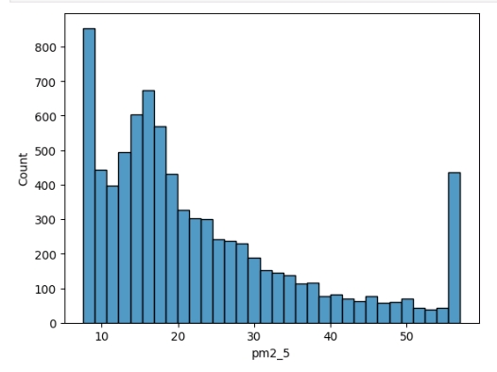
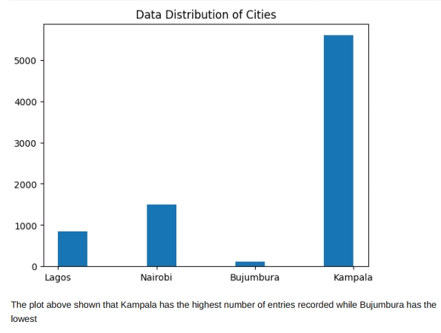
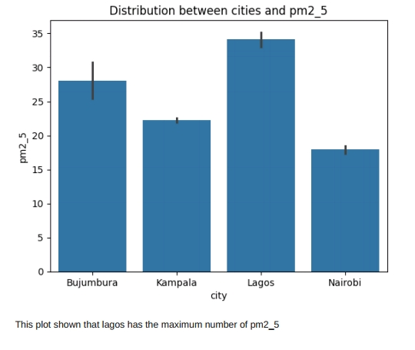
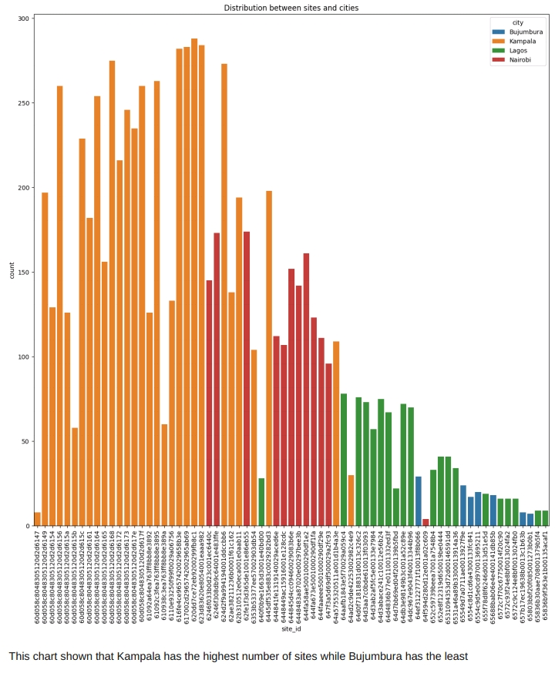
EDA

Slide 7
Feature Engineering
Feature Creation
Feature Selection
Five new features were created from existing features. The Feature from which the five new features were created from is the Date column . The Features created are:
Year
Month
Day
DayOfWeek
In order to have a good model performance, some feature are irrelevant to the model and was dropped. The feature are:
id,
date,
Some were already drop at the data cleaning stage because they contain about 94% of missing values.

Slide 8
Machine Learning
Model Development
Model Training
Developing a machine learning model that will be capable of estimating the PM2.5 levels from satellite observations based on Aerosol Optical Depth (AOD) is the objective of the project. In order to achieve it, the following Classifiers are selected for the model development:
Decision Tree Regressor
Random Forest Regressor
Ridge
XGBoost
All model trained on the data and used for predictions.
Evaluation Metrics
The key metrics for the model evaluation Root Mean Squared Error.
Random Forest Regressor outperform all other models developed.

Slide 9
Comparative Analysis
Model Development
Weaknesses: - Can be computationally expensive due to training multiple trees.
Decision Tree Regressor:
Strengths: - Interpretable and easy to understand. - Captures complex relationships in data.
Weaknesses:
Likely higher RMSE compared to Random Forest and XGBoost, indicating potentially inferior predictive accuracy.
Prone to overfitting and sensitive to noisy data.
Random Forest Regressor achieved the highest Root Mean Squared Error , which make it stands out among other models.
XGBoost also perform well follow by Decision Tree Regressor and Ridge.
Models Strengths and Weaknesses
Random Forest Regressor
Strengths:
It achieves the lowest RMSE among the models listed, indicating superior predictive accuracy in your context.
It reduces overfitting compared to a single decision tree by averaging multiple trees.

Slide 10
Comparative Analysis
XGBoost:
Strengths:
Offers competitive performance with a low RMSE, similar to Random Forest.
Handles missing data and captures complex relationships well.
Provides feature importance which aids in feature selection.
Weaknesses:
Requires careful tuning of hyperparameters.
More complex and less interpretable compared to simpler models.
Ridge:
Strengths:
Provides a stable and robust solution.
Handles multicollinearity well.
Weaknesses:
Highest RMSE among the models listed, suggesting lower predictive accuracy in this context.
Assumes a linear relationship between predictors and the target variable.

Slide 11
Conclusion
The Random Forest Regression model has demonstrated superior predictive performance compared to other models evaluated, as indicated by its lowest RMSE value among the options considered. Random Forest is known for its robustness against overfitting, thanks to the ensemble of decision trees and the averaging of results, which helps in improving generalization to new data.​ It provides insights into feature importance, aiding in feature selection and interpretation of the model's predictive behavior.​

